Slide 1
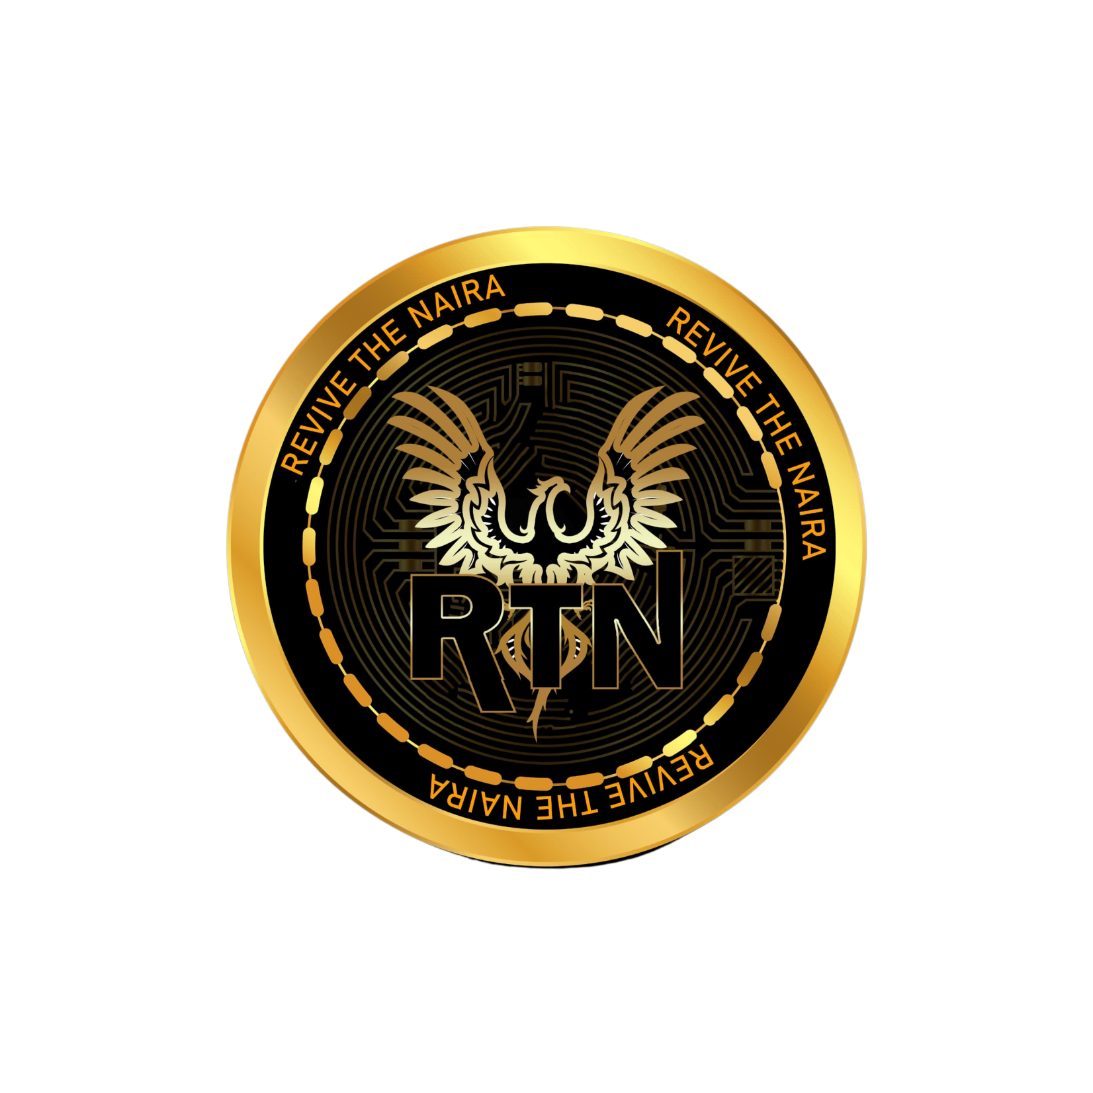
WHITE PAPER

Slide 2
ABSTRACT
Revive The Naira (RTN) is a token built on Blockchain technology, aimed at empowering the youth of Nigeria by providing them with access to capital for projects, while also addressing social issues such as poverty and education. By leveraging the power of Blockchain, RTN seeks to create a transparent and inclusive ecosystem that fosters economic growth and social development.

Slide 3
INTRODUCTION
The large youth population and socio-economic challenges in the world, stands at a pivotal moment in its development trajectory. The youth are the driving force of the nation's future, yet many lack the resources and opportunities to realize their full potential. Revive The Naira (RTN) seeks to bridge this gap by providing capital for youth projects and addressing pressing social issues, thereby empowering the youth and creating a more equitable society.

Slide 4
PROBLEM STATEMENT
Lack of Capital for Youth Projects: Many youth have innovative ideas and entrepreneurial aspirations but lack the capital to turn them into reality.
Poverty and Inequality: With economy grappling with high levels of poverty and income inequality, particularly affecting vulnerable groups such as women, children, and the elderly.
Limited Access to Education: Millions of children are unable to attend school due to financial constraints, perpetuating a cycle of poverty and deprivation.

Slide 5
SOLUTION
Revive The Naira (RTN) offers a multi-faceted solution to these challenges:
Capital for Youth Projects: RTN provides funding for youth-led projects and startups, enabling young entrepreneurs to access the resources they need to bring their ideas to fruition.
Poverty Alleviation: A portion of the proceeds from RTN transactions is allocated towards poverty alleviation programs, such as microfinance initiatives, vocational training, and job creation schemes.
Education Support: RTN funds are dedicated to paying school fees for underprivileged children, ensuring that every child has the opportunity to receive a quality education and break the cycle of poverty.

Slide 6
FEATURES
Project Funding: RTN token holders can propose projects for funding through a decentralized platform, where community members can vote on the allocation of funds.
Transparent Allocation: The allocation of funds for poverty alleviation and education support is recorded on the Blockchain, ensuring transparency and accountability in the distribution process.
Social Impact Metrics: RTN tracks the social impact of funded projects, including job creation, poverty reduction, and educational outcomes, providing stakeholders with real-time data on the token's social impact

Slide 7
UTILITIES
-Consistent Burning Mechanism
-Gaming Platform
-Staking Platform
-RTN will supports options, perpetual futures, and many other products within a single margin account. Combining off-chain matching with on-chain settlement

Slide 8
USE CASES
Peer-to-Peer Payments: Users can send and receive payments directly using RNT, bypassing traditional banking systems and reducing transaction costs.
Remittances: RTN provides a low-cost alternative for remittances, enabling individuals to send money home to their families with ease.
Microfinance: RTN can be used to facilitate microloans for aspiring entrepreneurs and small businesses, enabling them to access capital and fuel economic growth. Youth Entrepreneurship: RTN provides capital for youth-led startups and projects, fostering innovation and economic growth.

Slide 9
CONCLUSION
Revive The Naira (RTN) represents a bold vision for empowering the youth of and addressing pressing social issues through Blockchain technology. By providing capital for youth projects, alleviating poverty, and supporting education access, RTN aims to create a more equitable and prosperous society for all. Together, we can revive the spirit of the Naira and build a brighter future for the youth of. Thus reviving the Naira & the shine in the Shine.

