Slide 1
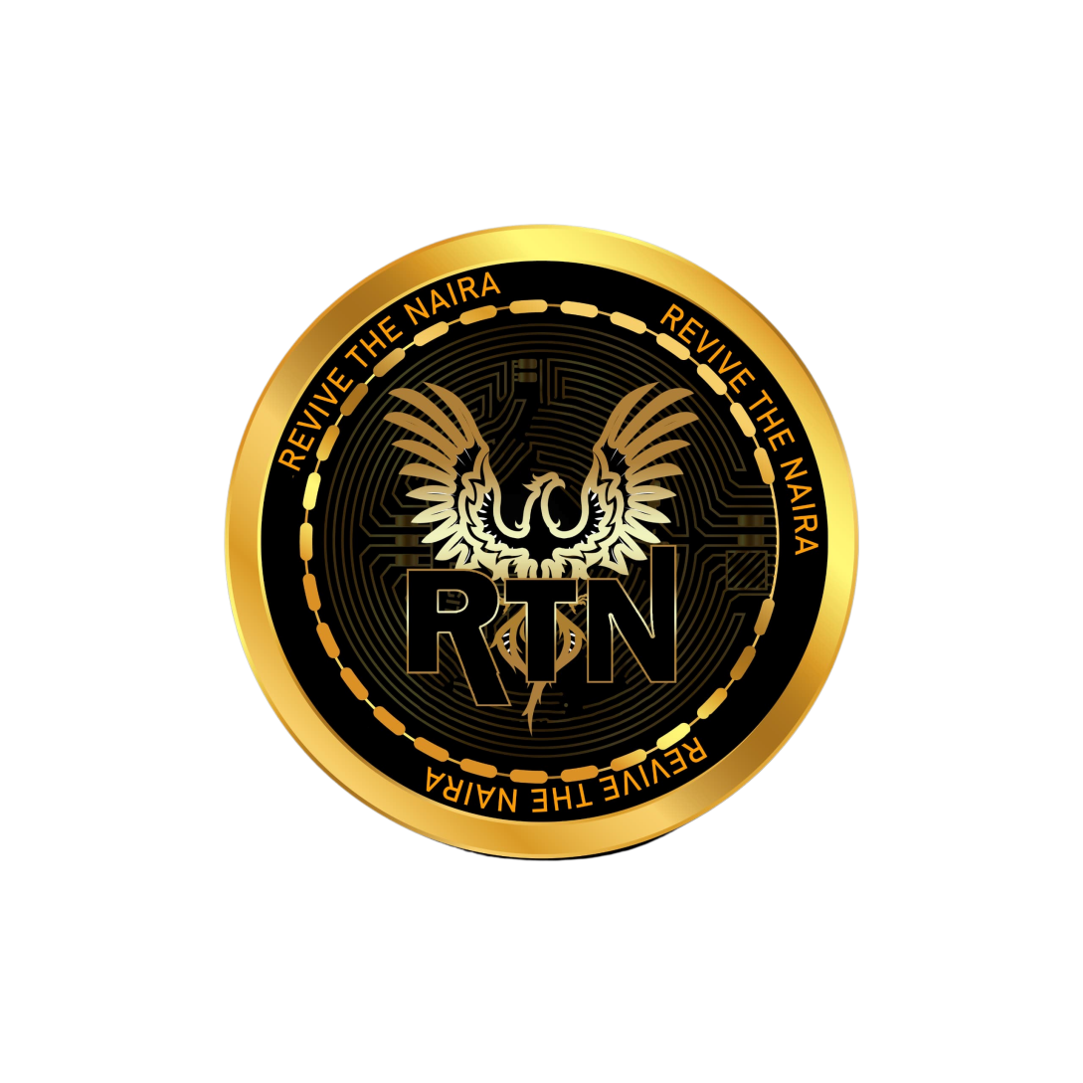
ROADMAP FOR REVIVE THE NAIRA

Slide 2
Supporting Options, Perpetual Futures, and Multiple Products in a Unified Margin Account

Slide 3
Phase 1: Foundation and Architecture
(Months 1-3)

Slide 4
Platform Design and Development
Assemble a team of blockchain and finance experts to design the architecture.
Select appropriate technologies, focusing on Binance Smart Chain (BSC) for security and scalability.

Slide 5
Smart Contract Development
Develop core smart contracts for margin trading, options, and perpetual futures.
Implement risk management protocols to ensure account security and prevent liquidations.

Slide 6
Off-chain Matching Engine
Build a high-speed matching engine to handle trading orders off-chain for optimal performance.
Integrate APIs for real-time data feeds from Binance and other major exchanges.

Slide 7
Phase 2: Product Integration
(Months 4-6)

Slide 8
Trading Integration
  Implement options trading functionality within the platform.
  Develop a user-friendly interface for creating and executing futures contracts.

Slide 9
Perpetual Futures Contracts
Integrate perpetual futures trading with leverage options.
Ensure seamless settlement and funding using on-chain mechanisms.

Slide 10
Multi-Product Support
Enable trading of various crypto assets including tokens, stablecoins, and popular DeFi assets.
Design a unified margin account system allowing users to trade multiple products with a single margin balance.

Slide 11
Phase 3: Testing and Security
(Months 7-9)

Slide 12
Testing and Optimization
Conduct extensive testing of the platform including stress testing and security audits.
Optimize smart contracts and matching engine for efficiency and low latency.

Slide 13
Security Integration
Implement multi-layered security protocols leveraging Binance Smart Chain's security features.
Integrate cold storage solutions for asset custody and user fund protection.

Slide 14
Phase 4: Launch and Scaling
(Months 10-12)

Slide 15
Public Beta Launch
  Launch a public beta version of the platform with limited functionalities.
  Gather feedback from early users to refine the user experience and identify potential issues.

Slide 16
Scalability and Future Enhancements
  Prepare for mainnet launch based on feedback and testing results.
  Plan for future enhancements including support for more trading pairs, advanced trading tools, and DeFi integrations.

Slide 17
Community Building
  Build a strong community around the platform through marketing efforts and educational initiatives.
  Engage with developers and traders to foster a vibrant ecosystem.

Slide 18
Phase 5: Post-Launch Growth (Ongoing)

Slide 19
Continuous Improvement
Regularly update the platform with new features and improvements based on user feedback.
Monitor and respond to market trends to stay competitive and innovative.

Slide 20
Partnerships and Expansion
  Seek strategic partnerships with other blockchain projects and financial institutions to expand the platform's reach.
  Explore cross-chain interoperability to support assets from multiple blockchains.

Slide 21
Regulatory Compliance
Stay updated with regulatory requirements and ensure compliance with relevant laws and regulations.
Work towards obtaining necessary licenses and approvals for operating in different jurisdictions.

Slide 22
By following this roadmap, RTN can successfully build a cutting-edge trading platform supporting options, perpetual futures, and various other products within a single margin account. The combination of off-chain matching with on-chain settlement ensures optimal performance, low latency, and enhanced security, leveraging the strengths of Binance Smart Chain.

